Slide 1




Flow Characterization of the University of Arizona Low Speed Wind Tunnel
2019 NASA Space Grant Symposium
April 13, 2019 – Tempe, AZ
Kirk Davis
University of Arizona
Department of Aerospace and Mechanical Engineering
Mentors: Dr. Jesse Little¹, David Borgmann², Dr. Philipp Tewes³
¹Associate Professor
²PhD Student
³Research Specialist
Notes:
Hello, my name is Kirk Davis and I am a junior studying Aerospace Engineering at the University of Arizona.
I work in the Turbulence and Flow Control Laboratory in the Department of Aerospace and Mechanical Engineering along with my mentors Dr. Jesse Little, David Borgmann, and Dr. Philipp Tewes to perform a Flow Characterization of the University of Arizona Low Speed Wind Tunnel.

Slide 2
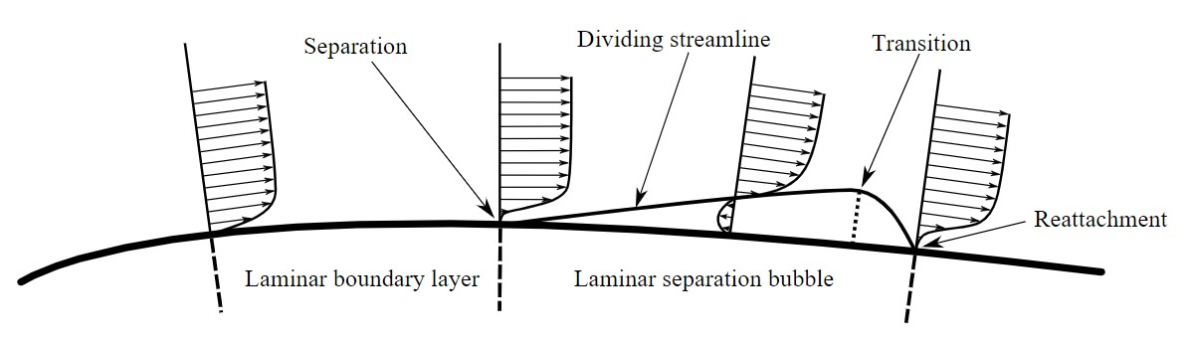
Background - Laminar Separation Bubbles
Mean Flow Field Schematic
Istvan, et al. (2016)
Laminar separation bubbles (LSBs) can form when a laminar boundary layer encounters an adverse pressure gradient
Flow instabilities initiate mixing and entrain high momentum fluid, leading to reattachment
LSBs are of critical importance for many aerospace applications as they can affect efficiency and performance
LSBs are important even up to Reynolds numbers of 1x10⁶
They are still not fully understood
Notes:
To begin, I will introduce the focus of our research: laminar separation bubbles.
Go through bullet points.
This schematic shows a time-averaged flow field, not an instantaneous flow field which will be shown next.

Slide 3
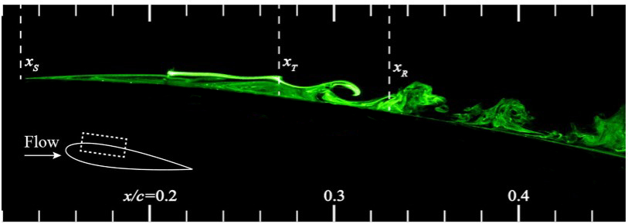
Laminar Separation Bubble
Instantaneous Flow Field Photo
Kirk, Thomas M., et al. (2017)
Notes:
Here we can see and instantaneous snapshot of the flow over an airfoil shape.
Near the top leading edge, we can see separation starting to occur and the laminar separation bubble forming at position x_S (separation).
Between x_S and x_T (transition region) the bubble is very susceptible to freestream disturbances.
The instabilities in this region caused by freestream disturbances promote the flow to transition from a laminar to turbulent structure.
After the x_T transition region, mixing occurs and entrains high-momentum fluid, which leads to reattachment of the flow near x_R.
After x_R, the fluid may become turbulent again and form additional vortices, but we are interested in the laminar separation bubble region.

Slide 4
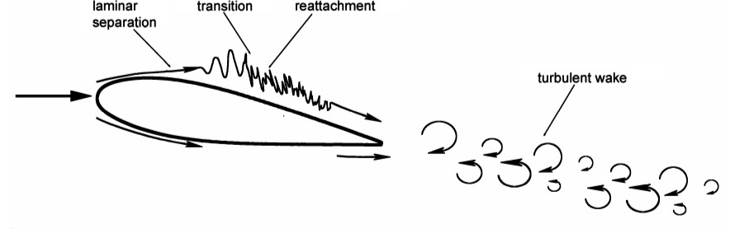
Laminar Separation Bubble
Yarusevych, Serhiy, et al. (2018)
Notes:
- Here is schematic depicting the instabilities that form along an LSB.
- We eventually hope to measure the instability frequencies in the boundary layer and along the bubble in our experiments.
- However, we must first measure the freestream turbulence in our tunnel before moving on to these bigger picture experiments.

Slide 5
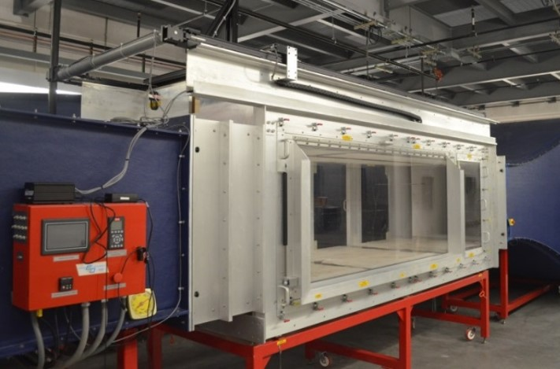
University of Arizona Subsonic Wind Tunnel
Investigation of LSBs requires a low turbulence facility
A detailed characterization of the freestream is necessary
University of Arizona Low Speed Wind Tunnel
3’ x 4’ x 12’ test section
Test section velocity from
5 to 80 m/s (16.4 to 262.5 ft/s)
(11.2 to 179.0 mph)
Notes:
Go through bullet points.

Slide 6
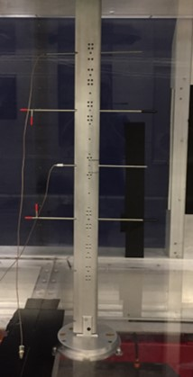
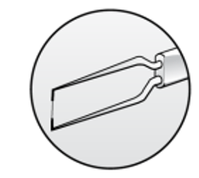
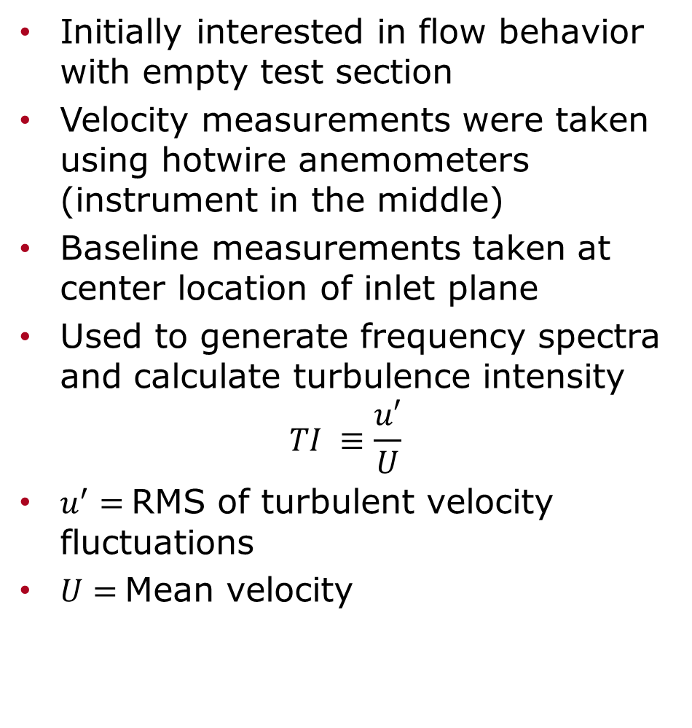
Time-Resolved Velocity Measurements
Initially interested in flow behavior with empty test section
Velocity measurements were taken using hotwire anemometers (instrument in the middle)
Baseline measurements taken at center location of inlet plane
Used to generate frequency spectra and calculate turbulence intensity
$$TI ≡\frac{u′}{U}$$
$u^{′}=$RMS of turbulent velocity fluctuations
$U=$Mean velocity
Dantec Dynamics (2019)
Notes:
Go through bullet points.
Mention time-resolved velocity measurements.

Slide 7
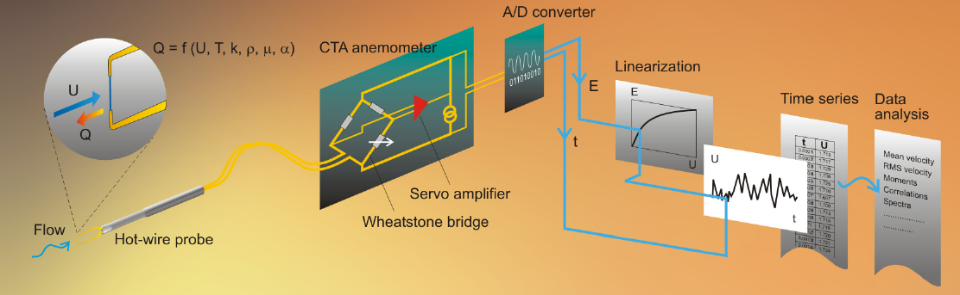
Hotwire Anemometers
Thermal anemometers, can be wires or films, fragile
Mean velocity and fluctuating velocity as well as direction
~50 kHz or higher frequency response
Dantec Dynamics (2019)
Notes:
Go through bullet points.
Hotwire anemometers keep a thin wire at a constant temperature by adjusting the voltage instantaneously
Due to convection, wire cools at higher speeds, which causes a higher voltage to be fed through the wire to keep it at a constant temperature.
This computer controlled voltage signal is converted to velocity values

Slide 8
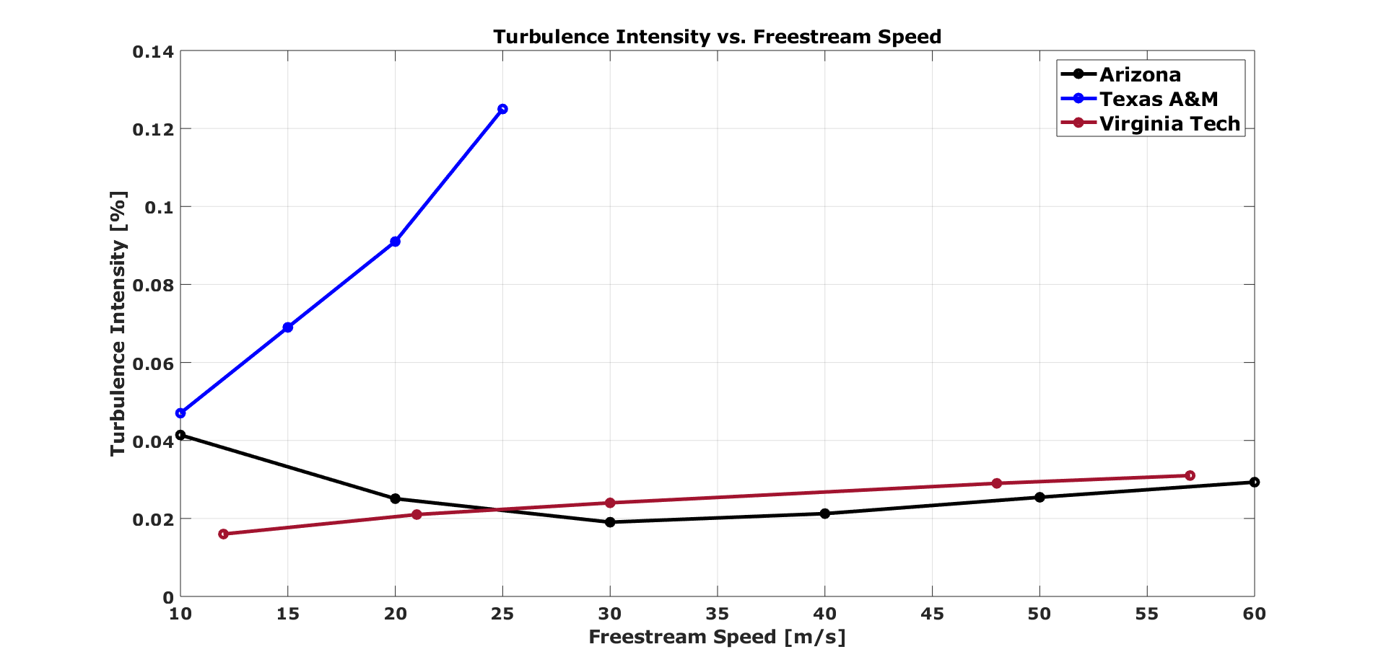
Turbulence Intensity Comparisons
Notes:
We calculated turbulence intensity at a broad range of speeds (10 – 60 m/s) and we observed that our turbulence intensity values are comparable, if not better than, similar wind tunnels at other academic institutions like Texas A&M and Virginia Tech.
If questions arise about difference in TI values between this figure and the contour plot:
This data is taken downstream in the test section, while the contour plot data is taken at the inlet.
The tunnel experiences higher TI along the length of the test section.
We took the data in this plot to compare with other available published data in these velocity ranges.

Slide 9
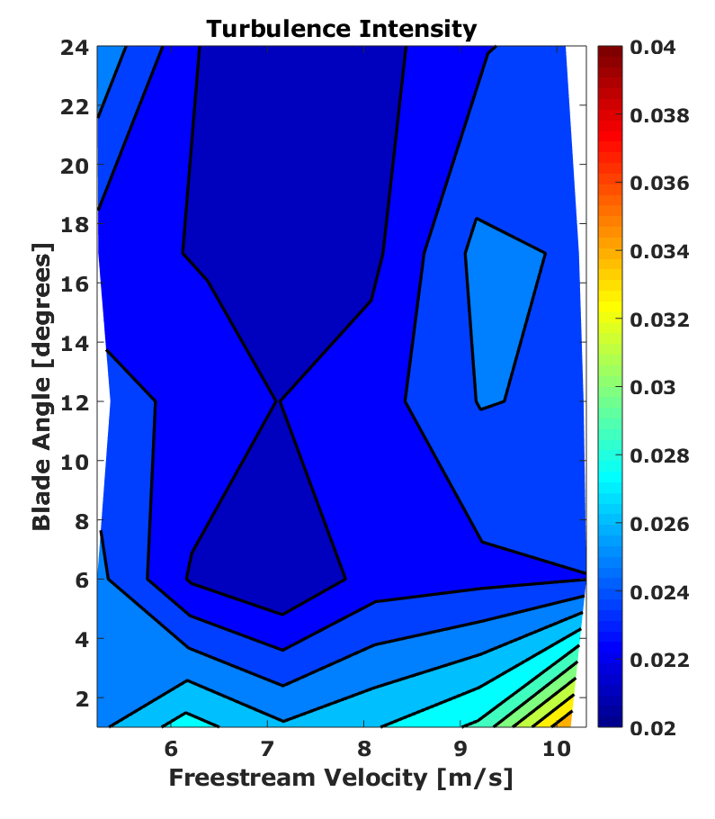
Finding Lowest Turbulence Intensity
Measurements taken for multiple freestream velocities at various fan blade angles
Two ways to change tunnel velocity:
  Adjust angle of fan blades in the motor
  Adjust motor RPM
Lowest turbulence intensity of 0.022% was achieved at:
  7 m/s
  17° – 24° fan blade angle
7 m/s result is desirable for direct numerical simulations
Notes:
We searched for the optimum freestream conditions by changing the tunnel parameters we are able to control, namely the motor RPM and the fan blade angle.
We tested speeds from 5 to 10 m/s and fan blade angles of 0 to 24 degrees.
The contour plot shown here displays the calculated turbulence intensity as a function of freestream velocity and fan blade angle.
The results of our testing matrix show that we achieve the lowest turbulence intensity, 0.022%, with a velocity of 7 m/s and a fan blade angle of 17 – 24 degrees.
This result is desirable for our planned direct numerical simulations since the simulation code takes weeks instead of months at slower speeds.
Detailed explanation: Calculations at higher Reynold’s number (i.e. higher velocities in our case) require smaller special resolution and smaller time steps, which necessitates more computational power and longer computational time.

Slide 10
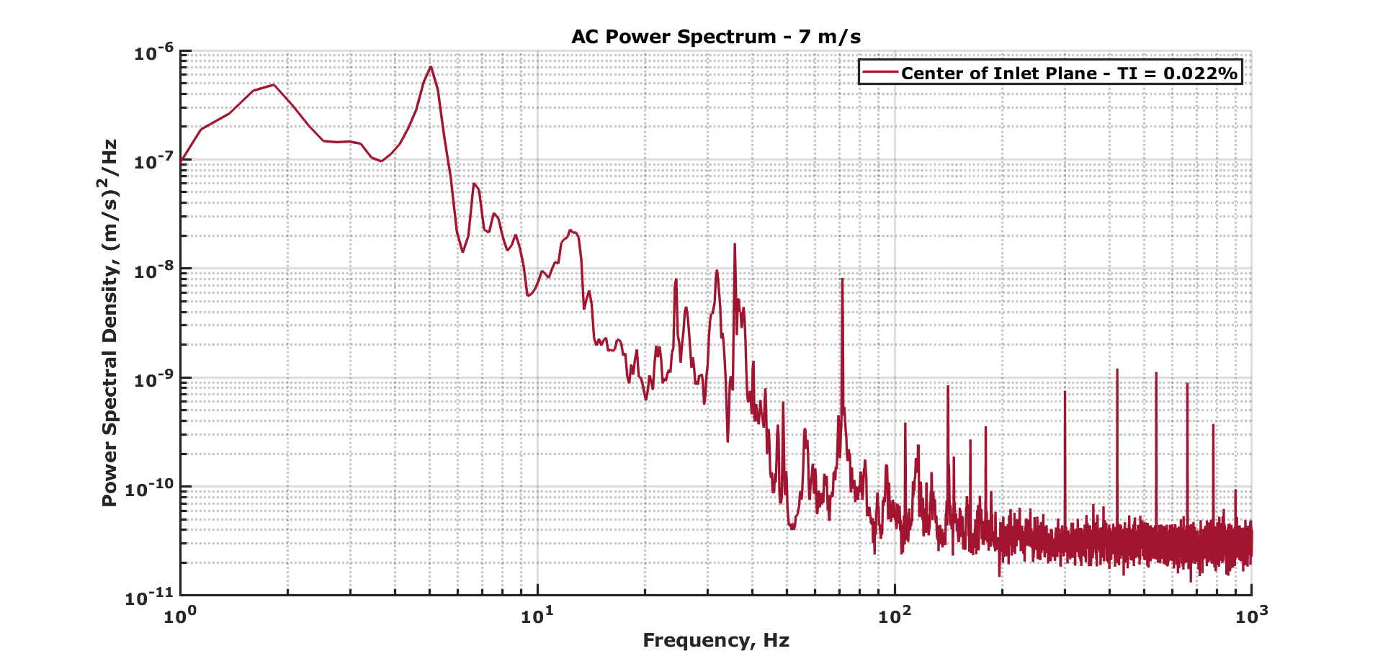
Hotwire Anemometer Frequency Spectra
Notes:
Frequency spectra show the frequencies and their amplitudes present in the flow
Can relate some peaks to tunnel parameters (tunnel RPM, number of fan blades, electrical noise etc.)
Bandpass from 1 Hz to10 kHz
Non-physical signals present at far end of frequency range
Note: The amplitude of the high frequency turbulence fluctuations are lower than our broadband electrical noise levels (noise floor), therefore, we are unable to distinguish those frequencies.
We used alternating current (AC) to take full advantage of our analog-to-digital converter since we can amplify the zero-centered fluctuating voltage signal to fill its entire range. Thus, we get better resolution of our data.

Slide 11
Conclusions
Lowest achievable turbulence intensity of 0.022% is comparable to, if not better than, similar facilities
  Klebanoff-Saric Wind Tunnel at Texas A&M
  Virginia Tech Stability Wind Tunnel
Observed very low turbulence intensity values for entire velocity range
Observed low turbulence intensity values at low speeds where we are able to run direct numerical simulations
Experimental conditions can be matched by direct numerical simulations
Notes:
Go through bullet points.

Slide 12
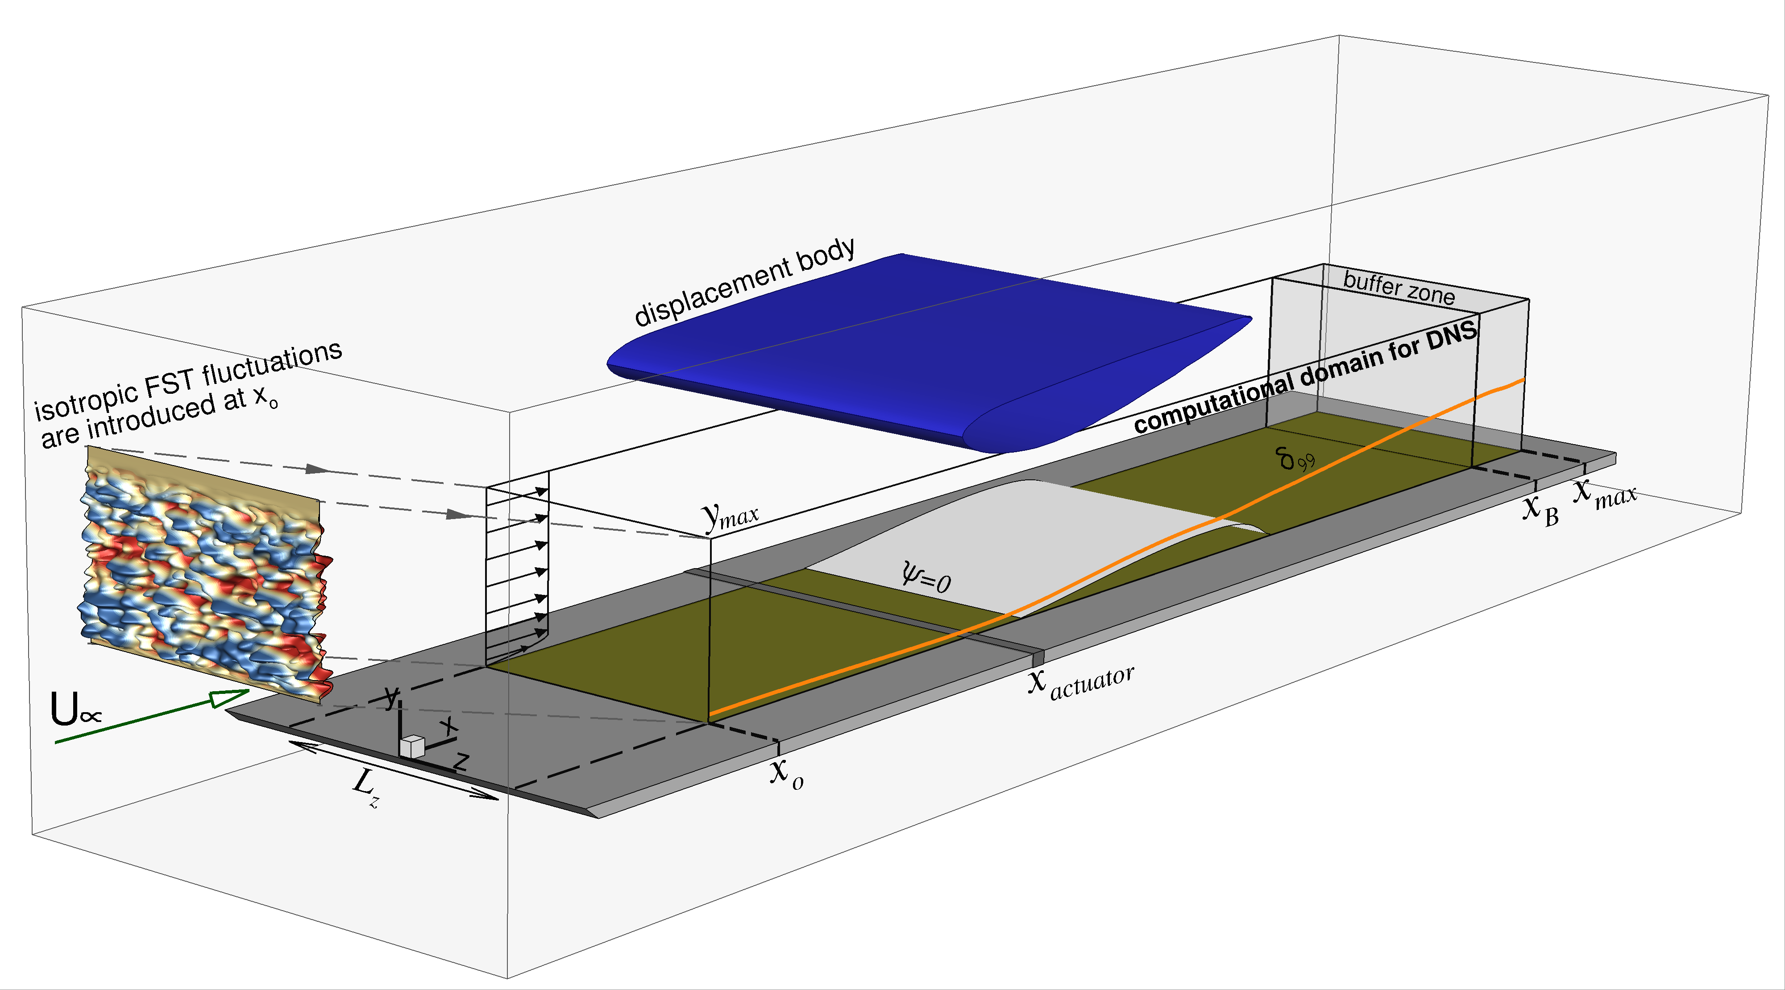
Future Work
Compare experimental and computational results
Model freestream turbulence at inlet for direct numerical simulations based on our measurements
Induce an LSB on a flat plate by imposing an adverse pressure gradient using a displacement body
Investigate boundary layer transition, separation, and reattachment on a flat plate
Hosseinverdi and Fasel (2017)
Notes:
Go through bullet points.
Point out introduction of freestream turbulence at inlet.
Point our displacement body which imposes an adverse pressure gradient, promoting an LSB to form.

Slide 13
Acknowledgements
Dr. Jesse Little
David Borgmann
Dr. Philipp Tewes
Shirzad Hosseinverdi
Turbulence and Flow Control Laboratory
University of Arizona Department of Aerospace and Mechanical Engineering
National Science Foundation
Arizona/NASA Space Grant Consortium
Notes:
- Acknowledge our great team!

Slide 14
References
Google Maps. 29 Mar. 2019. “Aerospace and Mechanical Engineering Building.”
Dantec Dynamics. 2019. “Constant Temperature Anemometry.”
Häggmark, Carl. 2000. “Investigations of Disturbances Developing in a Laminar Separation Bubble Flow.” Mekanik.
Hosseinverdi, Shirzad, and Hermann F. Fasel. 2017. “Numerical Investigation of the Interaction of Active Flow Control and Klebanoff Modes.” In 47th AIAA Fluid Dynamics Conference, 1–17. Reston, Virginia: American Institute of Aeronautics and Astronautics. https://doi.org/10.2514/6.2017-4419.
Istvan, Mark S., John W. Kurelek, and Serhiy Yarusevych. 2016. “Effects of Free-Stream Turbulence Intensity on Laminar Separation Bubbles.” 46th AIAA Fluid Dynamics Conference, no. June: 1–13. https://doi.org/10.2514/6.2016-3946.
Kirk, Thomas M., and Serhiy Yarusevych. 2017. “Vortex Shedding within Laminar Separation Bubbles Forming over an Airfoil.” Experiments in Fluids 58 (5): 1–17. https://doi.org/10.1007/s00348-017- 2308-z.
Yarusevych, Serhiy, John G. Kawall, and Pierre E. Sullivan. 2008. “Unsteady Separated Flow Characterization on Airfoils Using Time-Resolved Surface Pressure Measurements.” AIAA Journal 46 (2): 508–16. https://doi.org/10.2514/1.33306.

Slide 15
Thank You

Slide 16
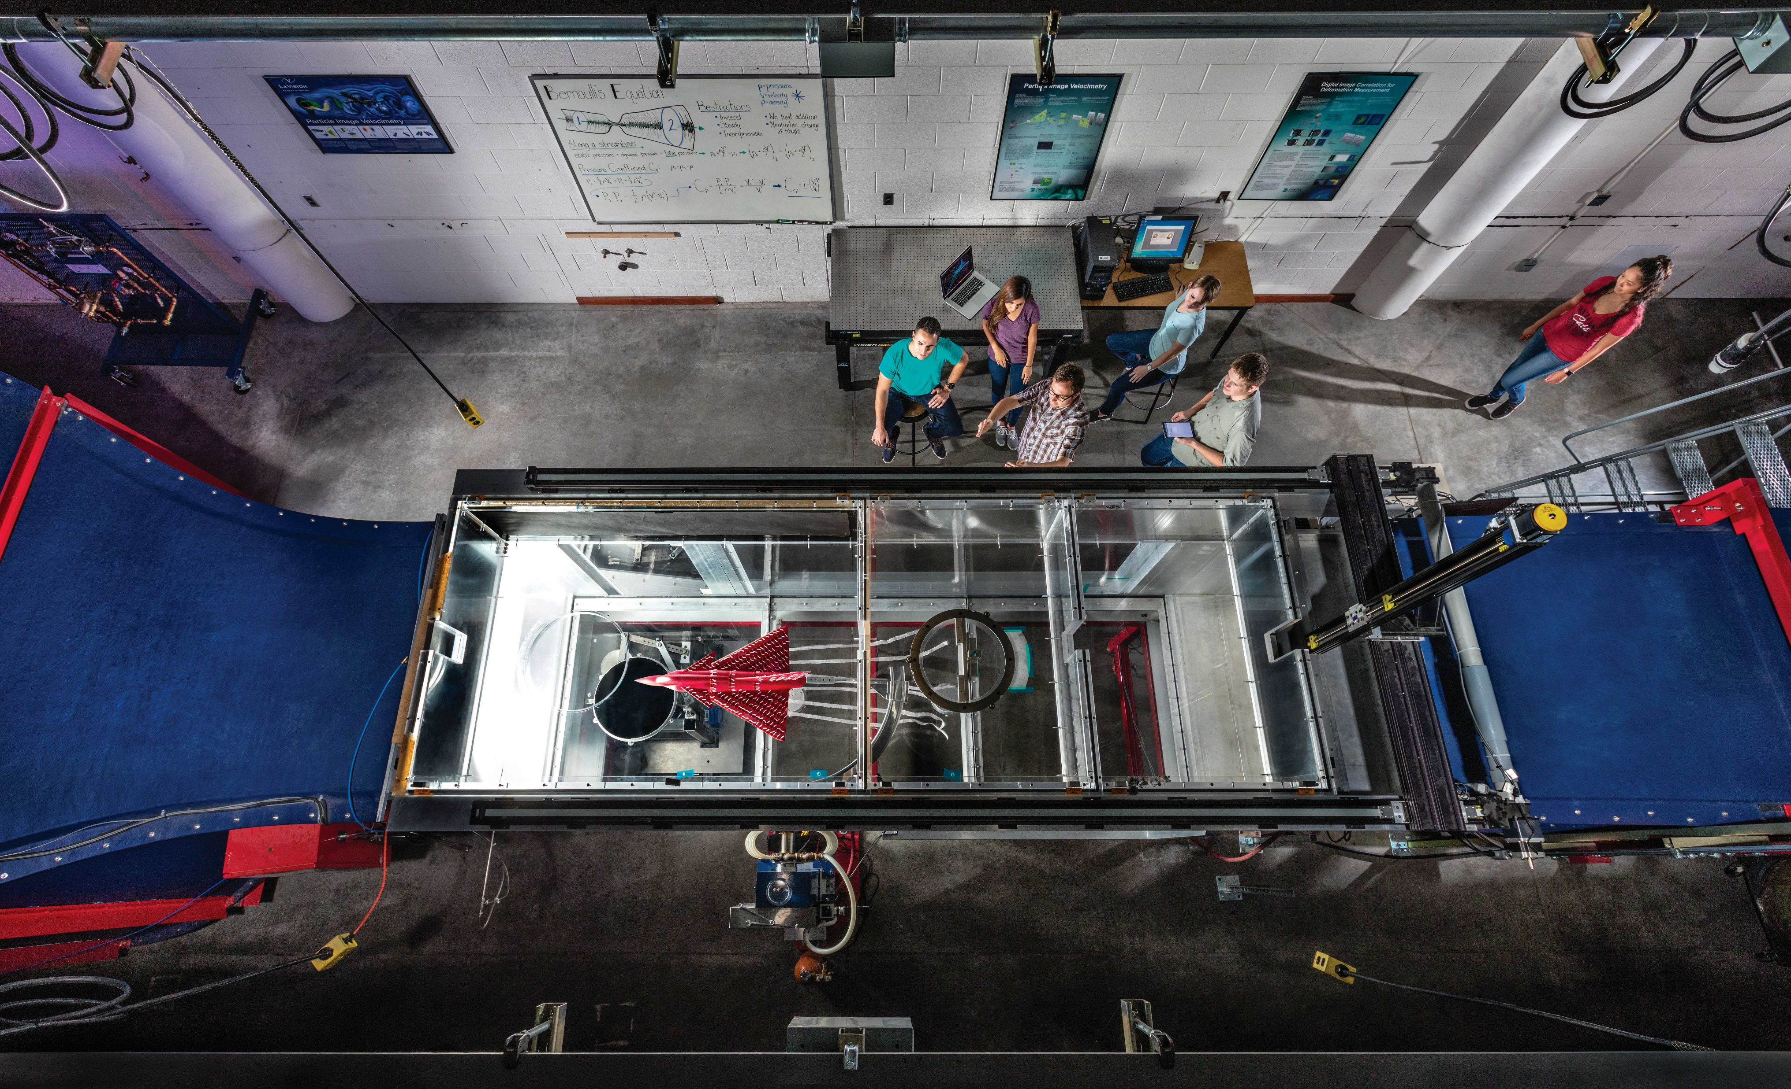
University of Arizona Subsonic Wind Tunnel
Notes:
- Extra photo of the University of Arizona Subsonic Wind Tunnel.

Slide 17
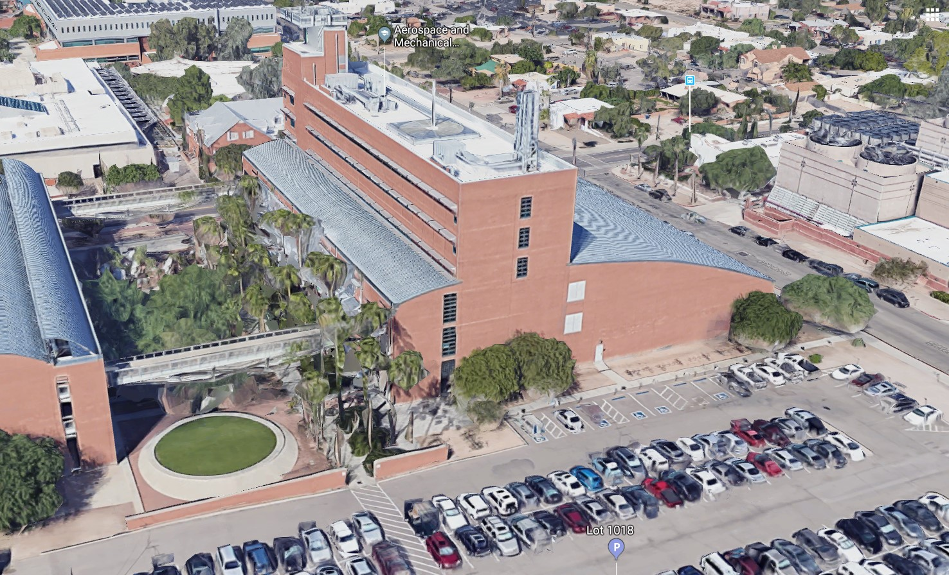
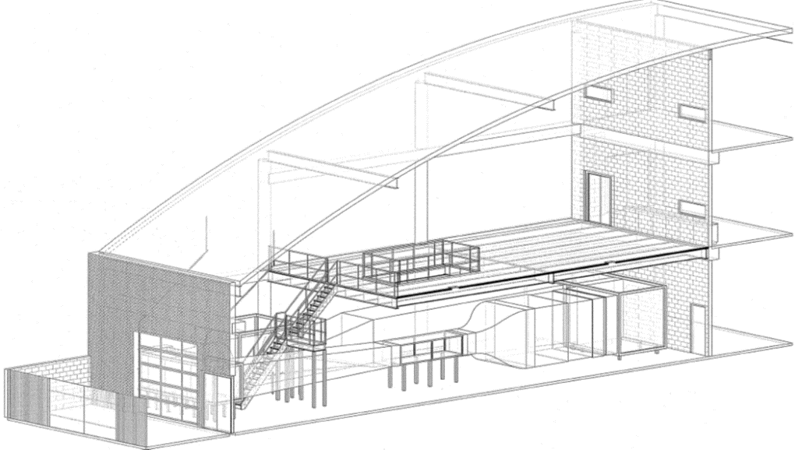
AME Facility
Google Maps (2019)
Notes:
- Extra slide if there is a question about the size of our facility.

Slide 18
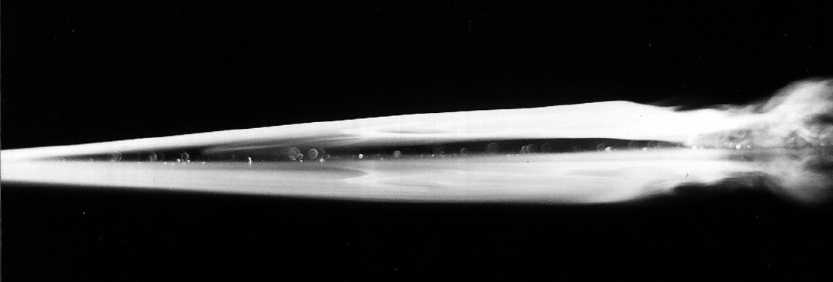
Laminar Separation Bubble
Häggmark, Carl. (2000)
Notes:
- Extra photo of a laminar separation bubble (instantaneous snapshot).

Slide 19
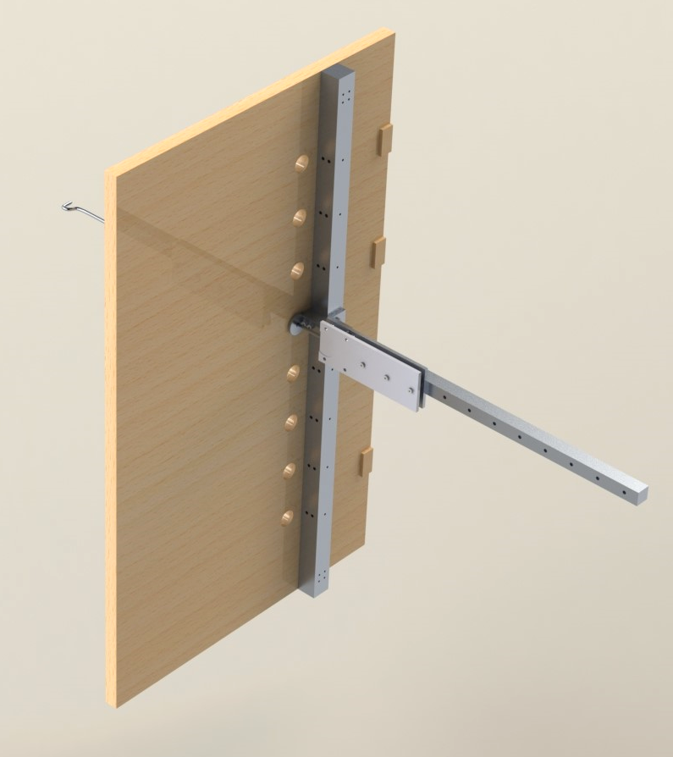
5-Hole Pitot Probe Manual Traverse
Holds a 5-hole pitot probe to measure pressure
Velocity information can be extracted from these measurements
4” x 4” measurement resolution
Replaces upstream test section hinged door
Notes:
- Extra slide about 5-hole pitot probe that we may use in the future.

